Slide 1
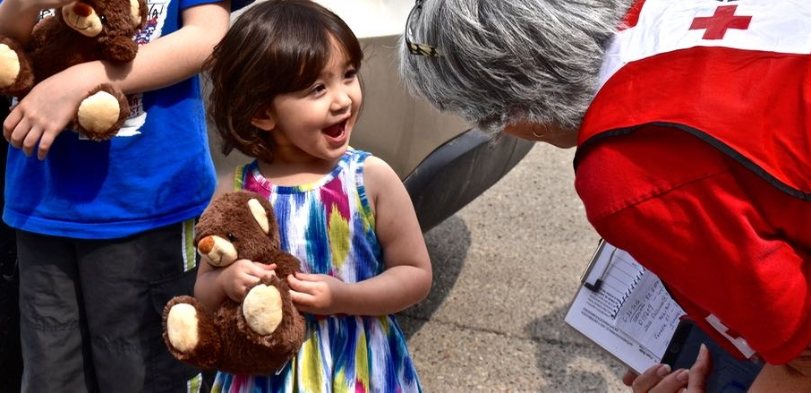
The Red Cross is there
Every day, during silent disasters, we are present in your community.
Notes:
The Canadian Red Cross and its volunteers are best known for their work during major responses, such as when forest fires forced the evacuation of close to 90,000 in Fort McMurray or when our volunteers helped welcome thousands of Syrian refugees.
More recently, we were all moved by stories from residents living in the municipalities hit by severe flooding due to heavy rain and those being evacuated by the fires in British Columbia. Thousands of people affected by the disaster have registered with the Red Cross for support.
The Red Cross also provides assistance during what we call “silent” disasters. These are fires, floods and evacuations that occur several times a day across the country and rarely make headlines.
Every year, you are there. Thanks to donors like you, the Red Cross is ready to assist those in need.

Slide 2
Our humanitarian commitment in Canada
Every 3 hours, Canadian families call on our help
20,000 volunteers active in our communities
Our teams are ready to help those affected by disasters, 24/7
Notes:
Here at home, disasters affect families:
Every three hours in communities across the country.
These are mainly fires, which can cause a family to lose everything in the blink of an eye.
Community-wide disasters
The Red Cross is the primary partner of public authorities when it comes to disaster management
Support is based on the specific needs of families and communities
Canadian families can rely on volunteers trained in disaster response that are ready to respond 7 days a week, 24 hours a day. In Canada, 20,000 volunteers watch over their communities.
The Red Cross responds daily and is ready to respond during large-scale events that affect entire communities:
Since the onset of the fires in BC, more than 49,000 people have been forced out of their homes and Red Cross has provided thousands with emergency financial assistance.
Following the spring floods in Québec, Ontario and BC, flooded households who registered with Red Cross received direct financial assistance. The Red Cross will continue to support them throughout their recovery.
Last year, over 1,000 volunteers supported the refugee arrival.
Four years after the disaster, the Red Cross is still helping Lac-Mégantic residents recover from the tragedy.

Slide 3
Our volunteers provide the essentials on a daily basis
Comfort, support and information
Shelter, food and emergency clothing
First aid and personal services
Notes:
Red Cross volunteers watch over your communities and are trained to respond to emergencies.
Donations from people like you help meet essential needs such as shelter, food and clothing while providing emotional support in times of difficulty. Our teams also provide blankets, personal care kits, as well as stuffed animals for children and essential baby items.
The first three days after a disaster strikes are the most critical. Volunteers make sure to guide those affected so that they can take necessary steps to get their lives back together as quickly as possible.
Volunteers can also refer those affected to community organizations that offer additional assistance.
Our donors enable us to provide assistance that is not only practical, but is also deeply human, respects the dignity of disaster victims and is a fundamental source of comfort.
With your support, the Red Cross is there to provide the essentials.

Slide 4
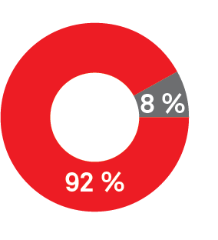
Fundraising
Nearly 92% of funds collected are used to provide free services to people affected by disasters.
Assistance for those affected by disasters
Fundraising costs
Notes:
The funds donated to the Red Cross to provide assistance to those affected by disasters in Canada are managed by the organization and are dedicated to Red Cross activities here.
Over the last five years, 91.7% of funds collected annually were dedicated to services offered to the population.
According to a recent survey*, the Red Cross is the most trusted social and community services organization.
Survey reference, if needed: *Étude sur les tendances en philanthropie au Québec en 2017, conducted by the Épisode and Léger Marketing firms

Slide 5
Your impact, in the midst of an emergency
Arnold and his friend received emergency assistance from the Red Cross after a tornado destroyed their home in LaSalle, Ontario.
“We were sitting in the carport when the storm came at us. We had no warning or time to prepare. It hit me really hard. The Red Cross came in and they helped me. They took care of me. ”
Notes:
Here is an example of the critical assistance the Red Cross can provide, thanks to donations:
“We were sitting in the carport,” Arnold said. “The storm came at us from behind. We had no warning or time to prepare.” Though he does not remember much else from that evening, he does recall the sense of panic and confusion he felt as the tornado touched down on the home the 60-year-old rented with a friend.
Volunteers supported them through this tough time:
“It hit me really hard. The Red Cross came in and they helped me,” said Arnold. “They took care of me.”
Thanks to your donation, Arnold and his friend received emergency assistance from the Red Cross after a tornado destroyed their home in LaSalle, Ontario.
Without you, none of our work is possible. Thank you!

